Slide 1
ENGI 301 Skittle Dispenser Proposal
10/3/2018
Nicholas Lester

Slide 2
Background Information
I am proposing to make a Skittle dispenser with the following functions:
Dispense candy with an IR sensor
Display the current fill level as a percentage of “full” by measuring the weight of candy
Give audio feedback when dispensing
Stretch goal: Send notifications over a network when fill level is low

Slide 3
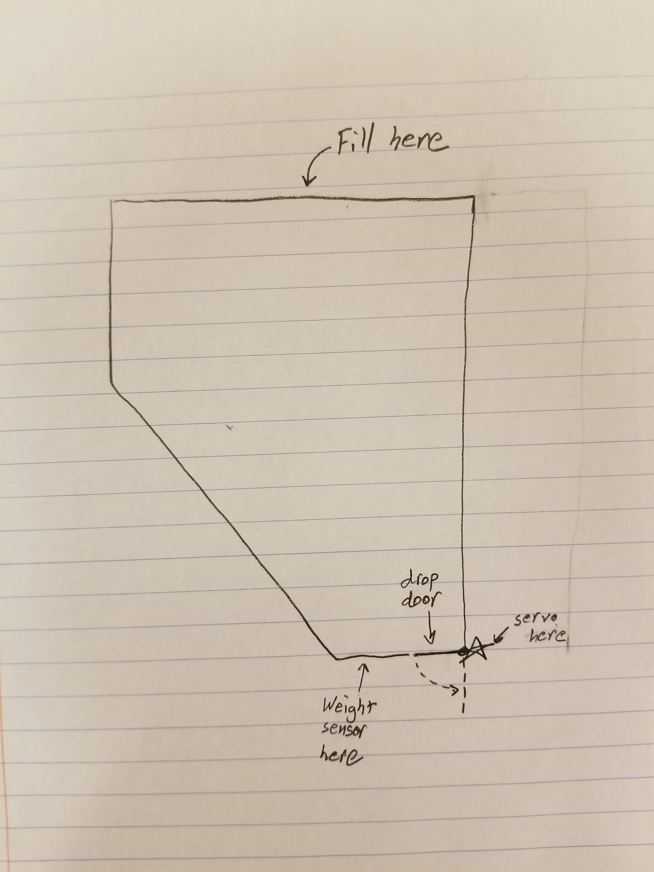
Container Design Sketch
The weight to fullness equation will be calculated through trial as the container is not a simple rectangle (there is the slant).
There will be some inaccuracy of the fullness measurement when the container is very close to empty.

Slide 4
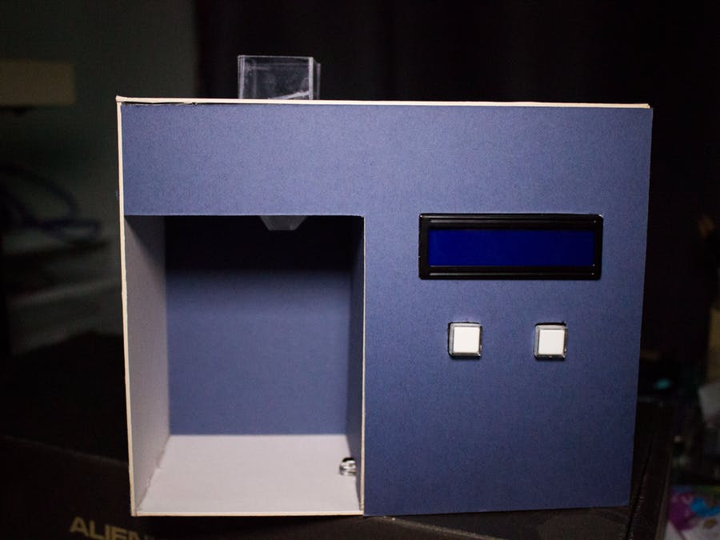
Background Information
Existing project: https://www.hackster.io/hadamiera/candy-dispenser-a61a60
Improvements: By structuring the design differently and adding a weight sensor, you will be able to know how much candy you have left in the dispenser.
Existing project

Slide 5
System Block Diagram
IR Sensor
PocketBeagle
Micro Servo
GPIO
PWM1
Piezo Element
FSR
AIN_IN
MicroUSB
USB0
Adafruit 4-Digit Display
I2C1_SCL
I2C1_SDA

Slide 6
Power Block Diagram
IR Sensor Part 1
20 mA total
5 Volts
IR Sensor Part 2
PocketBeagle
5 Volts
Micro Servo
SYS_VOUT
SYS_VOUT
~ 3 mA
Piezo Element
5 Volts
3.3 Volts
FSR
3.5 mA
SYS_VOUT
3.3V_OUT
~ 1 mA
3.3 Volts
Adafruit 4-Digit Display
MicroUSB
5 Volts
3.3V_VOUT
VIN_USB
~ 160 mA

Slide 7
Components / Budget
Component | Need to Buy | Cost
Micro Servo (Adafruit) | 1 | $5.95
Square Force-Sensitive Resistor (FSR) – Interlink 406 | 1 | $8.95
IR Break Beam Sensor - 3mm LEDs | 1 | $1.95
Large Enclosed Piezo Element w/Wires | 1 | $0.95
Resistors | 0
PocketBeagle | 0
Adafruit 0.56" 4-Digit 7-Segment Display w/I2C Backpack | 0
Breadboard | 0

